Slide 1


AYITI ANALYTICS PROBABILITY AND STATISTICS PROJECT
Group 5

Slide 2
Table of contents
Introduction
Problem
Methodology
Results
Discussion & Proposed Solution
Alternative Solution
References & Appendices
Team Members

Slide 3
Introduction
Ayiti Analytics Data Laboratory is a data lab that applies advanced analytics and other emerging technology to improve the quality of life of people across socioeconomic and geographical areas. Ayiti Analytics is a leader in the areas of analytics and advanced computing which is demonstrated through technical education programs, corporate consulting and public research.

Slide 4
Problem
Every year Ayiti Analytics organizes a bootcamp with the aim of training young people in Data science. This year to start the course, they offer an online introductory course as part of the process of selecting the participants of the bootcamp. Few of those who registered as participants paid the online course fees. They are looking for options that allow them to increase their sales while having more female applicants.

Slide 5
Methodology
To complete this project, we use data collected from Ayiti analytics website during the selection process of the 2021 cohort for the bootcamp.8 datasets containing information about each applicants were obtained.:
Those datasets were aggregated and than analyze using python 3.8. Descriptive analysis were made for the age of applicants. Bivariate analysis were conducted between the payed and gender, bootcamp interest, communication channel.

Slide 6
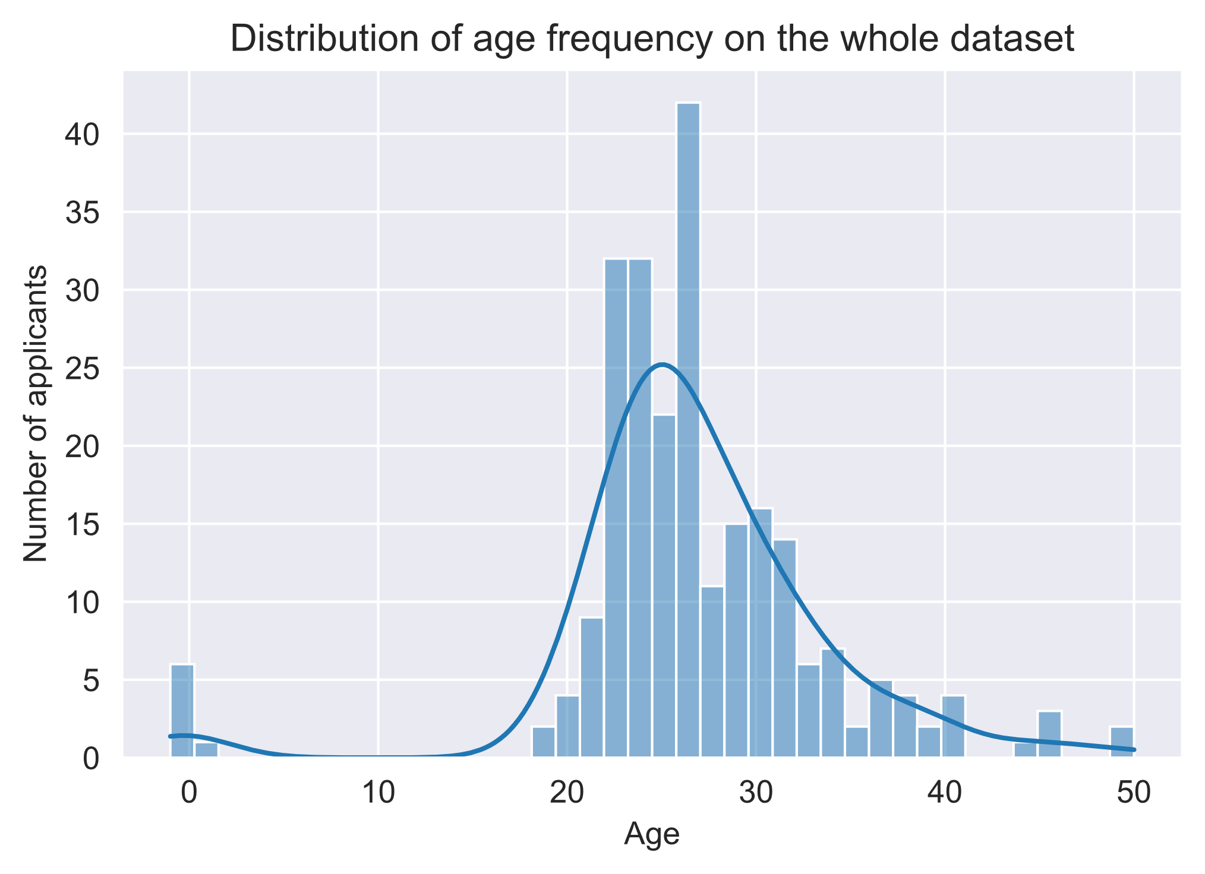
Results

Slide 7
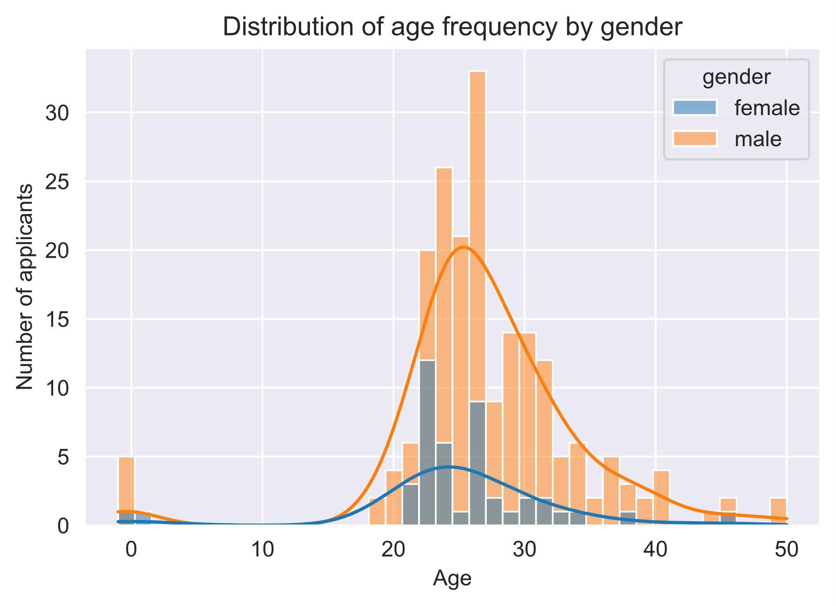
Results

Slide 8
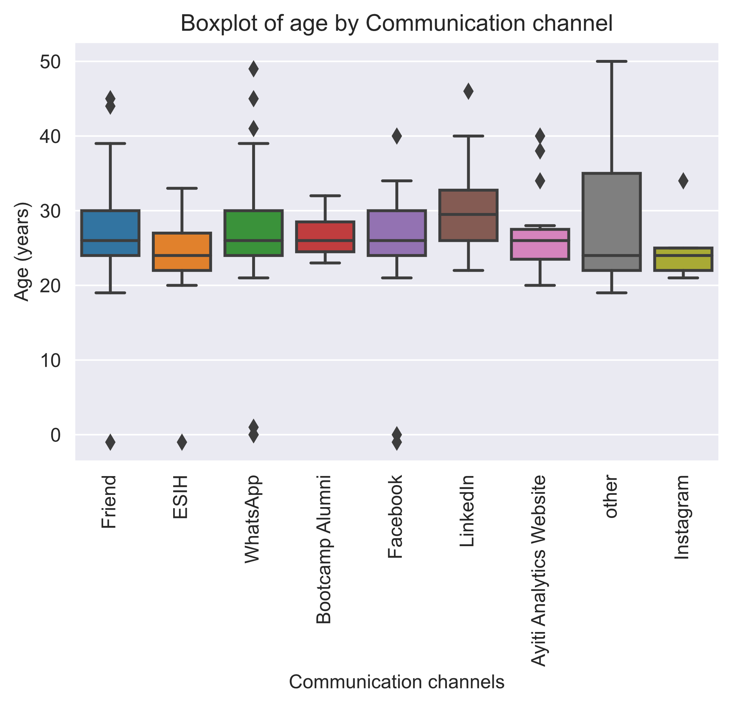
Results

Slide 9
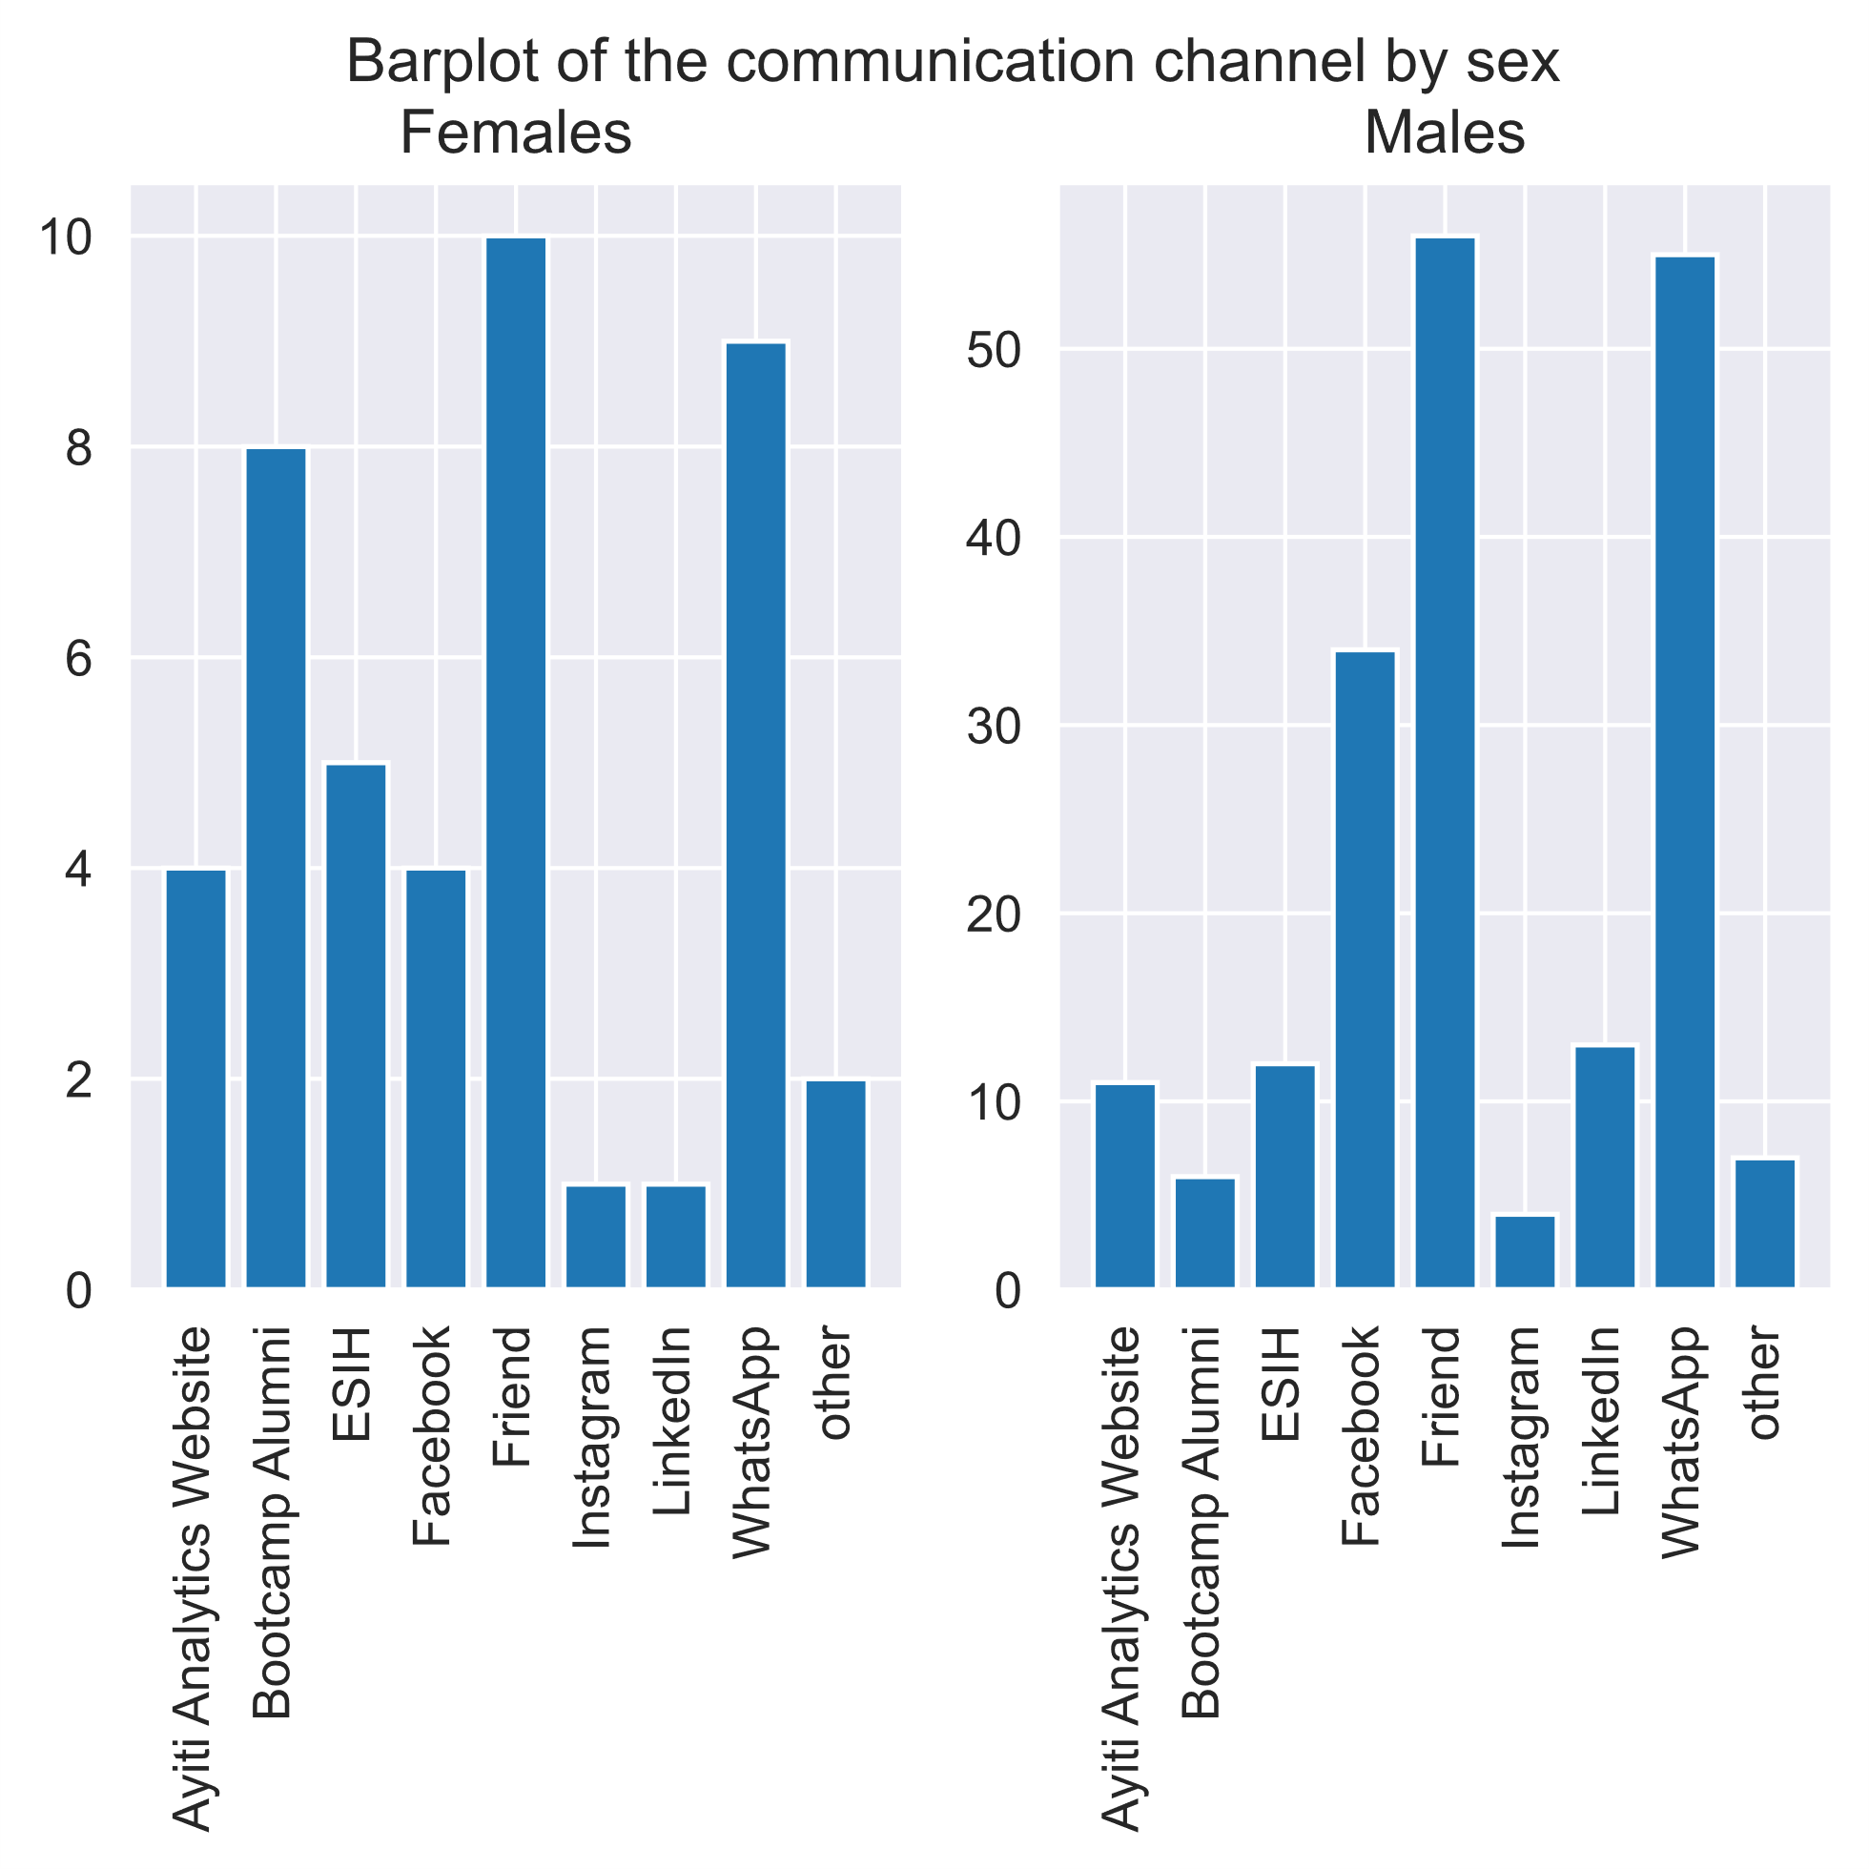
Results

Slide 10
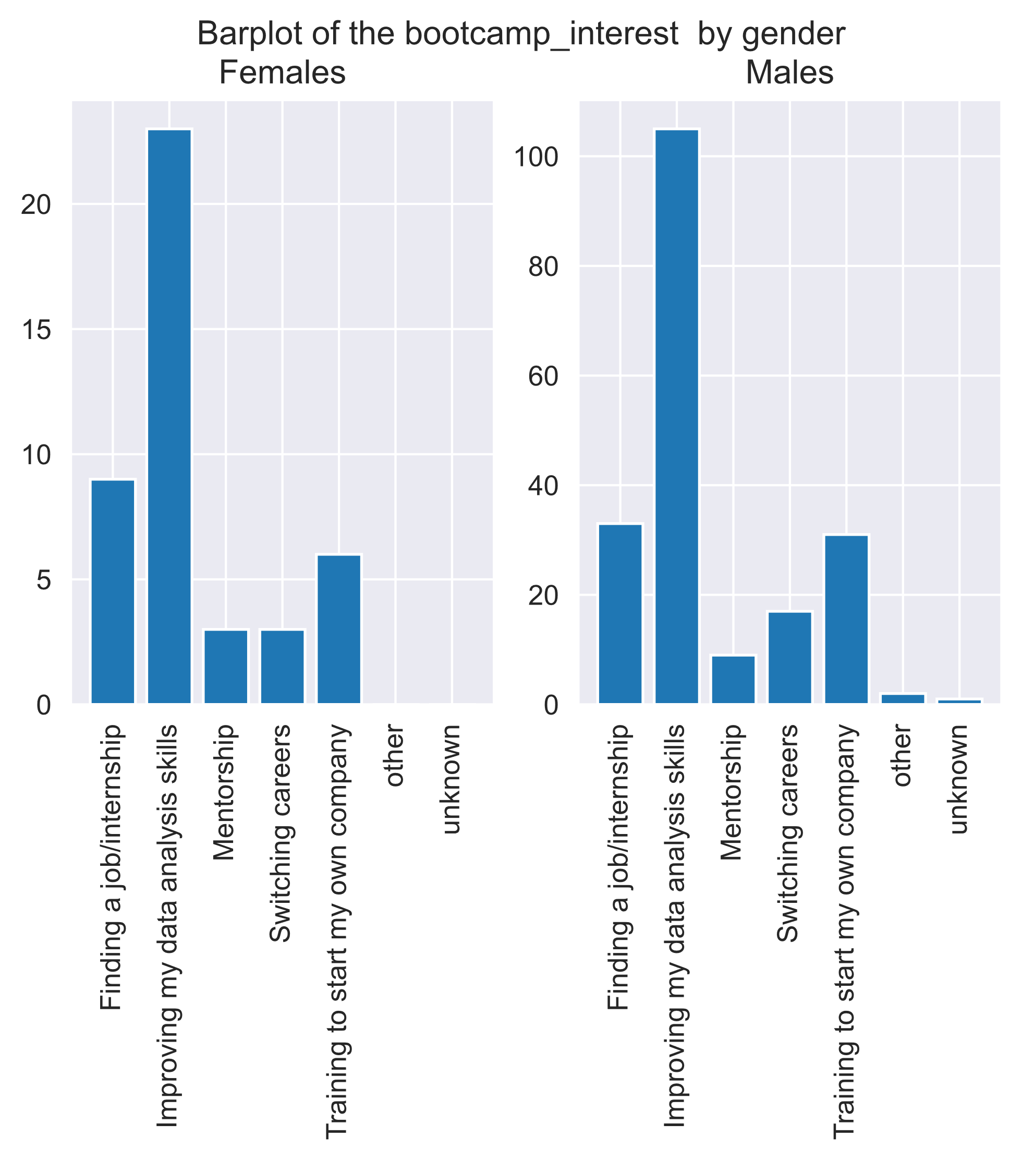
Results

Slide 11
Discussion & Proposed Solution
Solutions and Recommendations
Related to gender and communication channel
As the gender and communication channel are correlated we can increase our chance of having participant of a specific gender by prioritizing one channel over the other.
We are more likely to select a female by prioritizing those channel: "Friend","whatsapp","Bootcamp Alumni"
We are more likely to select a male by prioritizing those channel: "Friend","whatsapp","Facebook"
*As we can see the male and female most used communication channel diverge by one channel, therefore prioritizing facebook or Bootcamp alumni will influence tho poll of participant toward man or woman..

Slide 12
Discussion & Proposed Solution
Solutions and Recommendations
Related to gender and bootcamp interest
As the gender and bootcamp interest aren't correlated we can't increase our chance of having participant of a specific gender by prioritizing one interest over the other.
Related to sale increase
Using adds targeting less man as they have a 95,45% probability of not buy the course
* Prioritizing communication channels other than the friend channel as those have a 92.42% probability of not buy the course
* Using adds not targeting people looking to improve their analytical skills as they have a 92.18% probability of not buy the course

Slide 13
Thank you
for you attention

